Slide 1
Solid Rocket Booster
UNH SEDS
Charlie Nitschelm

Slide 2
Main Differences between a SRB and LRB
Type of Propellant
Ignition Sequence
Run Time
Storing
Complexity

Slide 3
The Parts of a SRB
Igniter
The Grain
Thrust Vector Control
Nozzle Throat

Slide 4
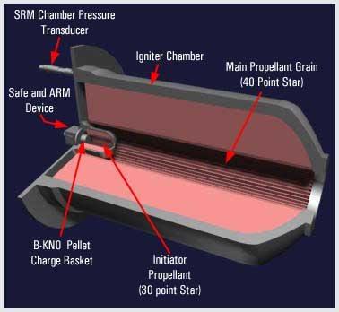
Igniter
To start the burning of the propellant in the SRB
Electric Ignition to start igniter.

Slide 5
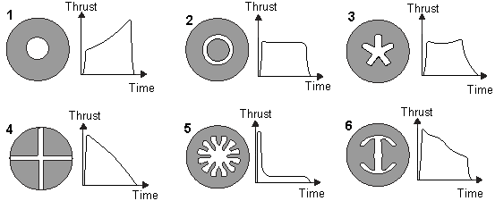
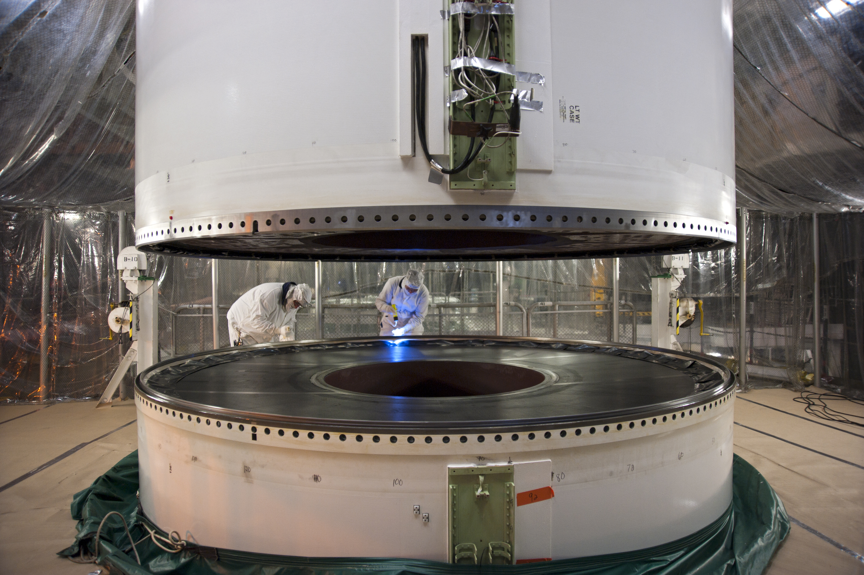
The Grain
The solid body of propellant and accounts for 85-95% of the mass of SRB
Determines what thrust you will achieve per unit of time

Slide 6
Thrust Vector Control
Center of Pressure and Center of Mass
Insert that rotates and can change thrust vector
Is it need for our scale of a rocket?
Great CoP and CoM might be enough for our needs

Slide 7
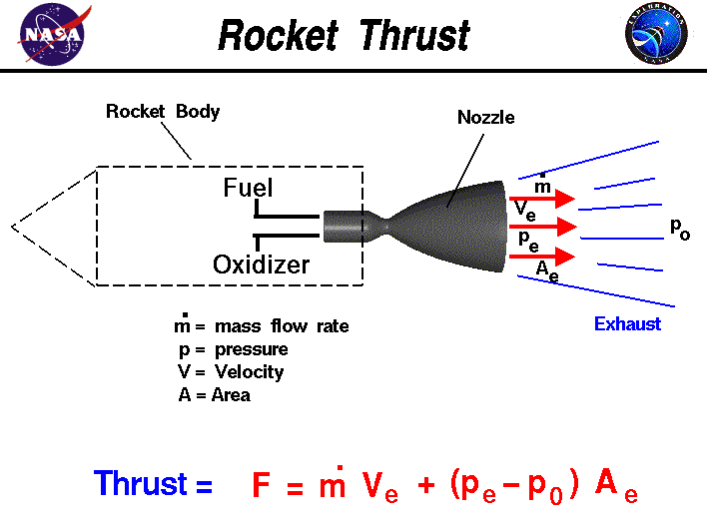
Nozzle Throat
Mass flow rate is determined by the Nozzle Throat
Difference in Pressure and pressure control is very important

